Slide 1
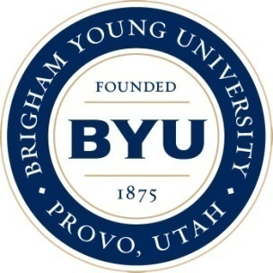
New Time Reversal Parities and Optimal Control of Dielectrics for Free Energy Manipulation
Scott Glasgow
Brigham Young University, Provo Utah 84602 USA
glasgow@math.byu.edu
Chris Verhaaren
University of Maryland, Department of Physics
cver@umd.edu
John Corson
Brigham Young University, Department of Physics
jcorson@byu.edu
Frontiers in Optics 2010 /Laser Science XXVI
October 24-28, Rochester New York
OSA’s 94th Annual Meeting

Slide 2
Funding—many thanks!
Research facilitated by NSF Grants No. DMS-0453421 and DMS-0755422.

Slide 3
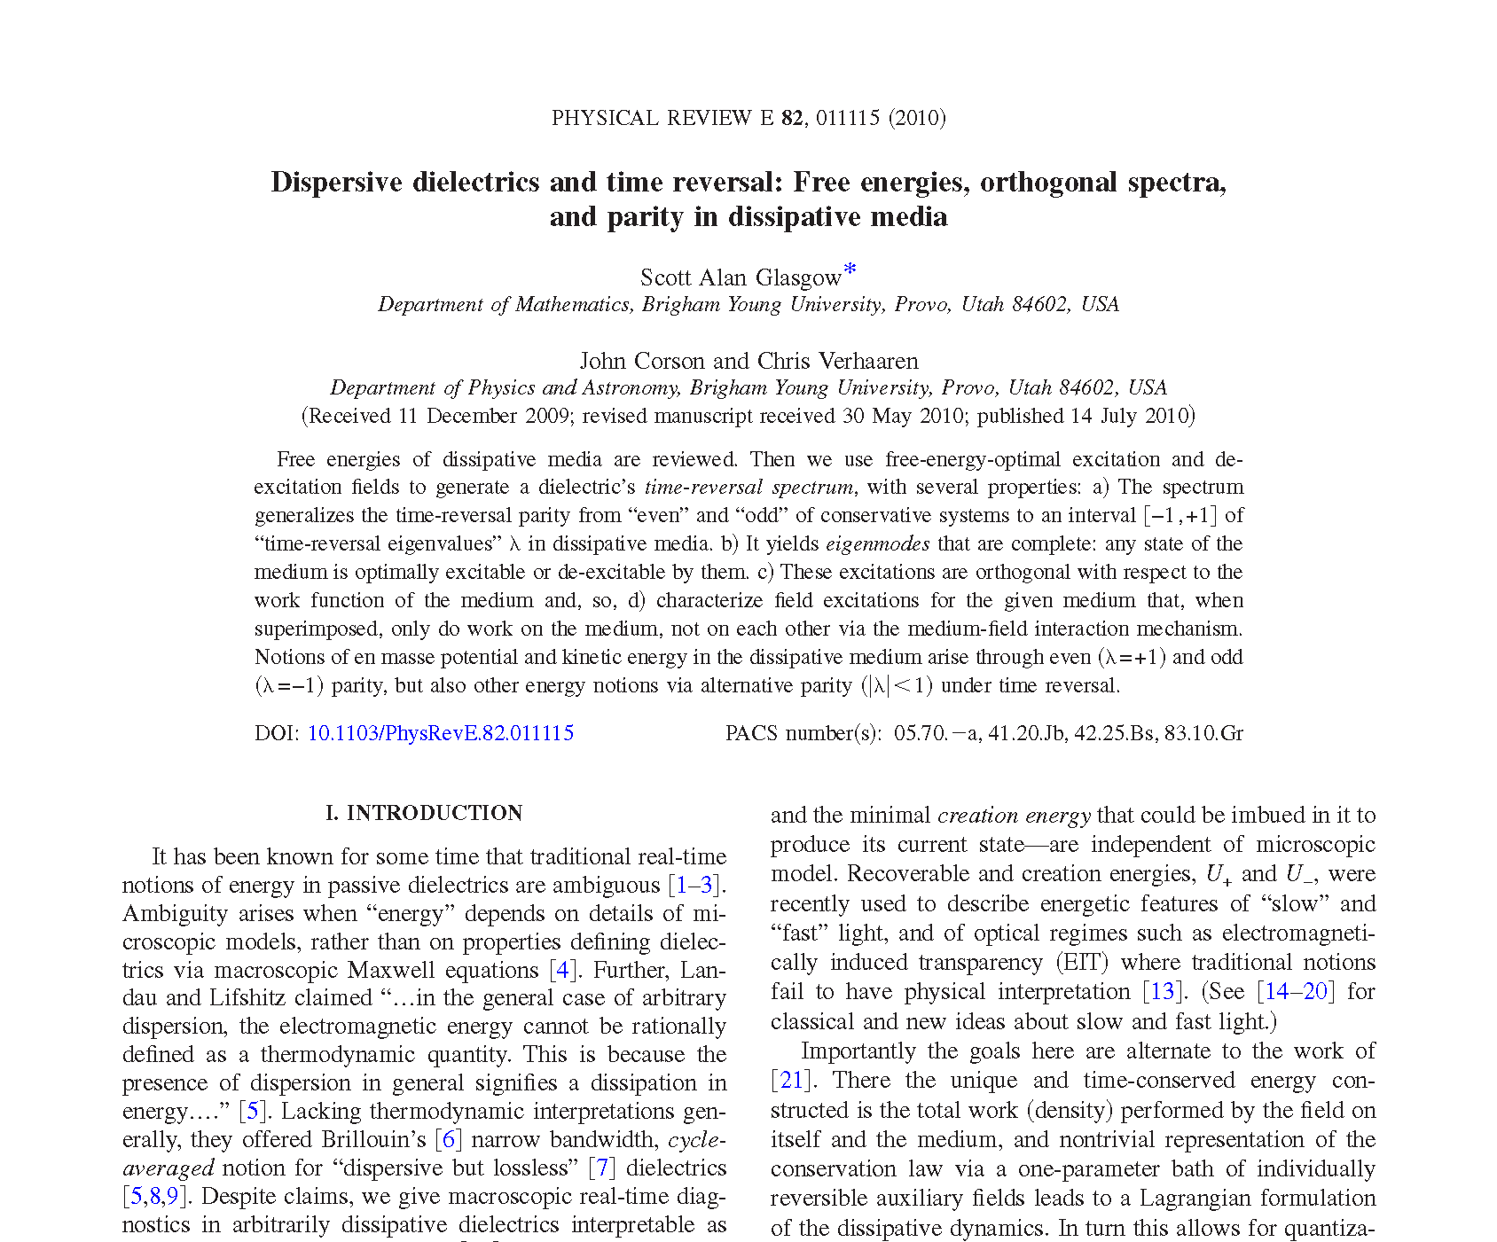

Slide 4
Optimal Control of Dielectric Media:
Optimally Slow and Fast Light
Noise reduction
Ultra-high sensitivity interferometry
Ultra-high speed and low power optical switching
Network traffic management
All things “all-optical”: buffering, synchronization, memory, signal processing

Slide 5
Usual Non-Optimal Approaches to Slow Light—Linear Media
Approaches are “frequency local”= narrow band—make index as steep as possible at favorite frequency.

Slide 6
Time-Frequency Optimal Approach—Linear Media
Approach: Frequency-global/wide-band analysis of , hence of
“Orthogonal decomposition of ”!

Slide 7
Time-Frequency Optimal Approach=Energy Optimal Approach
Slowed Pulse
Unaffected Pulse
Optimal/Broadband design of pulse for medium = energy-minimal excitation + energy maximal de-excitation of medium
Slowing Medium

Slide 8
Free Energies of Dielectrics: tutorials from viscoelasticity
M. Fabrizio and J. Golden, “Maximum and minimum free energies for a linear viscoelastic material,” Quart. Appl. Math. 60, 341–381 (2002).

Slide 9
Unified View of Max and Min Free Energies: Time-reversal
S. G., John Corson and Chris Verhaaren “Dispersive dielectrics and time reversal: Free energies, orthogonal spectra, and parity in dissipative media,” Phys. Rev. E 82, 011115 (2010).

Slide 10
Unified View of Max and Min Free Energies: Time-reversal

Slide 11
Max and Min Free Energies: “classical” E.E. and V.E. theorems
Global/wide-band analysis of :
Physical Hypotheses:
Ensuing 2 Theorems:

Slide 12
Max and Min Free Energies: “classical” E.E. and V.E. theorems
Global/wide-band analysis of :
Physical Hypotheses:
Ensuing 2 Theorems:

Slide 13
Max and Min Free Energies: “classical” E.E. and V.E. theorems
Global/wide-band analysis of :
Physical Hypotheses:
Ensuing 2 Theorems:

Slide 14
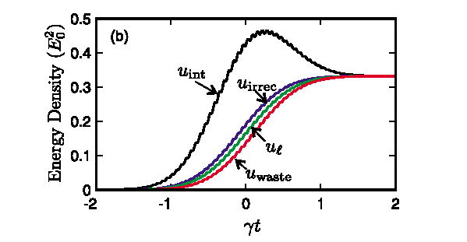
Max and Min Free Energies: “classical” E.E. and V.E. theorems
2 Notions of loss:
3rd Theorem:

Slide 15
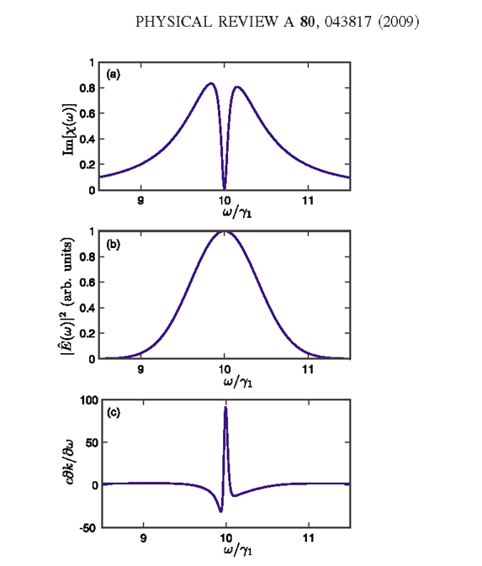
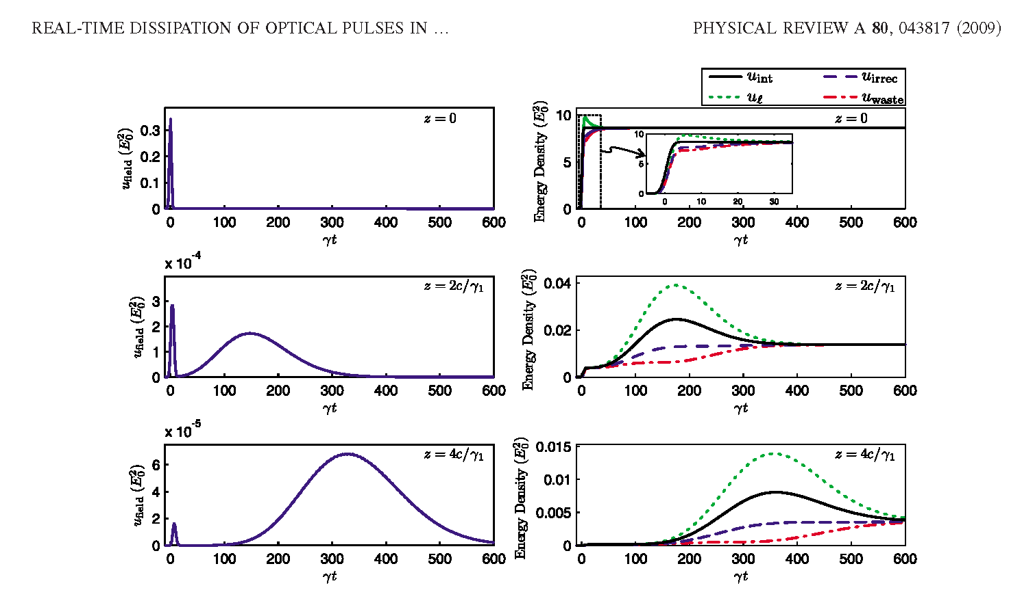
Fast/Slow Light Mixture: Analysis by Max and Min Free Energies
Notes:
Group delay description: each spectral component in the pulse is delayed according to its group delay. Since there are frequency components with both superluminal and highly subluminal delays, this pulse breaks into two pieces as it propagates see right fig. The superluminal spectral components experience a large amount of absorption (compare left fig a and c) so the peak of energy that arrives at early times is absorbed before reaching large propagation distances. At large propagation distances, the slow/late components dominate.
Recoverable and Creation Energy description of reshaping: At all depths u_waste and u_irrec both track closely total work done during the early portion of the
pulse. So energy transferred into the medium during the early portion of the pulse is largely “stuck” (u_irrec) in the medium at that point—not returnable. On the other hand, the absorption at z=0 happens asymmetrically around the peak of the pulse at t=0: more energy absorbed from the trailing/later edge of the pulse than the leading edge—this is evidenced by u_int~u_waste~u_irrec less than half way absorbed by t=0, the largest absorption coming on the back half then of the pulse. (And since these all track each other closely, the second two monotonic, u_int is nearly—but not quite—monotonic) This explains the superluminal propagation predicted by the group delay method (left fig, middle) at very small propagation depths. At greater propagations depths the frequency components that experience superluminal delays have been absorbed, and the overall behavior of the pulse is dominated by the frequency components with highly subluminal delays. The energy exchange behavior for these frequency components is well illustrated by the frames for z
=2c/1 and z=4c/1. Note that a large fraction of the energy transferred from the early portion of the “slow” part of the pulse into the medium remains undissipated at these spatial positions—u_int deviates from either notion of loss significantly at later times—allowing u_int to be significantly non-monotonic, the decreasing phase (at even longer times) indicating energy being returned to the back end of the pulse, i.e. indicating subluminal behavior. So, in this case, the tortoise beats the hair at large distances, and we can see why this can occur in terms of the various notions of energy loss.

Slide 16
Time-Reversal and the Effective Susceptibilities: Simplest Examples
S. G., John Corson and Chris Verhaaren “Dispersive dielectrics and time reversal: Free energies, orthogonal spectra, and parity in dissipative media,” Phys. Rev. E 82, 011115 (2010).

Slide 17
Time-Reversal and the Effective Susceptibilities: Simple Example
S. G., John Corson and Chris Verhaaren “Dispersive dielectrics and time reversal: Free energies, orthogonal spectra, and parity in dissipative media,” Phys. Rev. E 82, 011115 (2010).

Slide 18
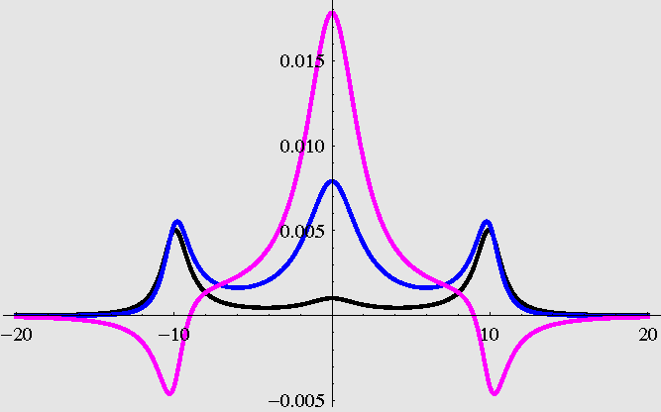
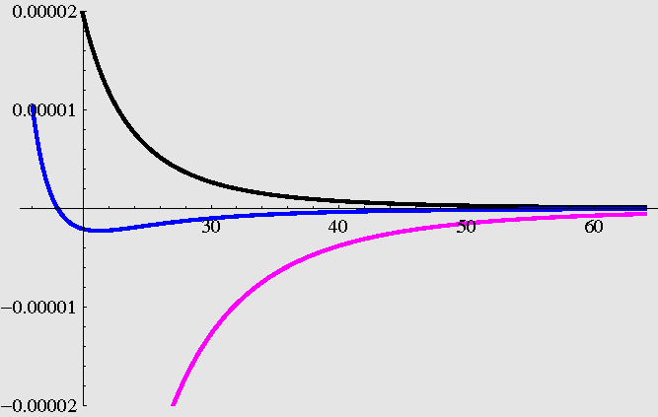
Time-Reversal and the Effective Susceptibilities: Simple Example
The creation energy effective susceptibility is always passive for DC, active near positive resonance.
The recoverable energy effective susceptibility is here passive for DC, active “near infinity” . This may be reversed, or it may be passive for all frequencies.
S. G., John Corson and Chris Verhaaren “Dispersive dielectrics and time reversal: Free energies, orthogonal spectra, and parity in dissipative media,” Phys. Rev. E 82, 011115 (2010).

Slide 19
Time-Reversal and “Eigen-Susceptibilities”: The Fundamental Theorem
The Fundamental time-reversal orthogonality theorem:
Time reversal eigenvalues and their susceptibilities for
the example :
S. G., John Corson and Chris Verhaaren “Dispersive dielectrics and time reversal: Free energies, orthogonal spectra, and parity in dissipative media,” Phys. Rev. E 82, 011115 (2010).

Slide 20
Summary and To Do:
Excitation field=time-reversed multiple of energetically optimal de-excitation field implies…
multiple is special—time reversal eigenvalues
excitation field is itself energetically optimal
excitations are complete in state space
excitations are orthogonal with respect to the work function
two excitations have even and odd parity, i.e. eigenvalues +1 and -1, corresponding to potential and kinetic energy, and other parities exist for, and only for, multi-resonance systems.
energetic orthogonality gives rise to “orthogonal decomposition of ”
Current eigenvalues are “spatially local”—useful only for “thin media”
Compute optimal free space pulse to a) impart energy to “thick” medium most efficiently and then b) extract energy from medium most efficiently—spatio-temporal Carnot cycle
Inverse problem: what resonance structure allows the above to occur for a simple, narrow-band pulse? Conjecture: likely significantly different than EIT resonance/dissipation structure.

